Slide 1


BANK ANALYTICS
Group No : 4
Group Members
Amol Ahire
Johan Prince
Muskan Choudhary
Payal Lanje
Shreyash Mhaskar
Suyash Bagul

Slide 2

Project Objective
Currently our team was provided with a project named BANK LOAN ANALYTICS.
In this project we handled two datasets which had more than 39k data.
The main aim was to analyze the growth rate of the bank after lending loans between 2007 to 2011.
The tool which we used to clean the data and remove duplicates from the datasets was mainly done in EXCEL.
We prepared DASHBAORDS and created multiple KPI’s for analysis using EXCEL, TABLEAU and POWER BI, and we verified the final output using MYSQL.

Slide 3
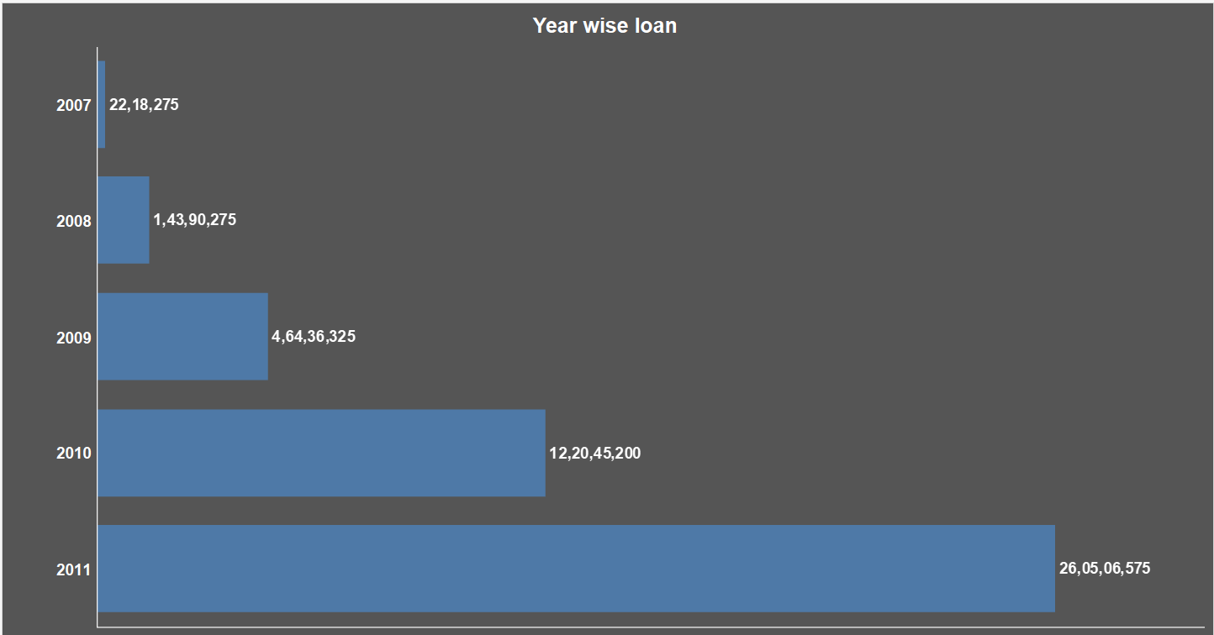
Year Wise Loan Amount
By observing the chart, we can see how Loan Amount is increasing year by year.
The highest loan amount was disbursed in the year 2011, totaling approximately 26,05,06,575. This indicates that 2011 had the highest demand or availability of loans compared to other years in the dataset.

Slide 4

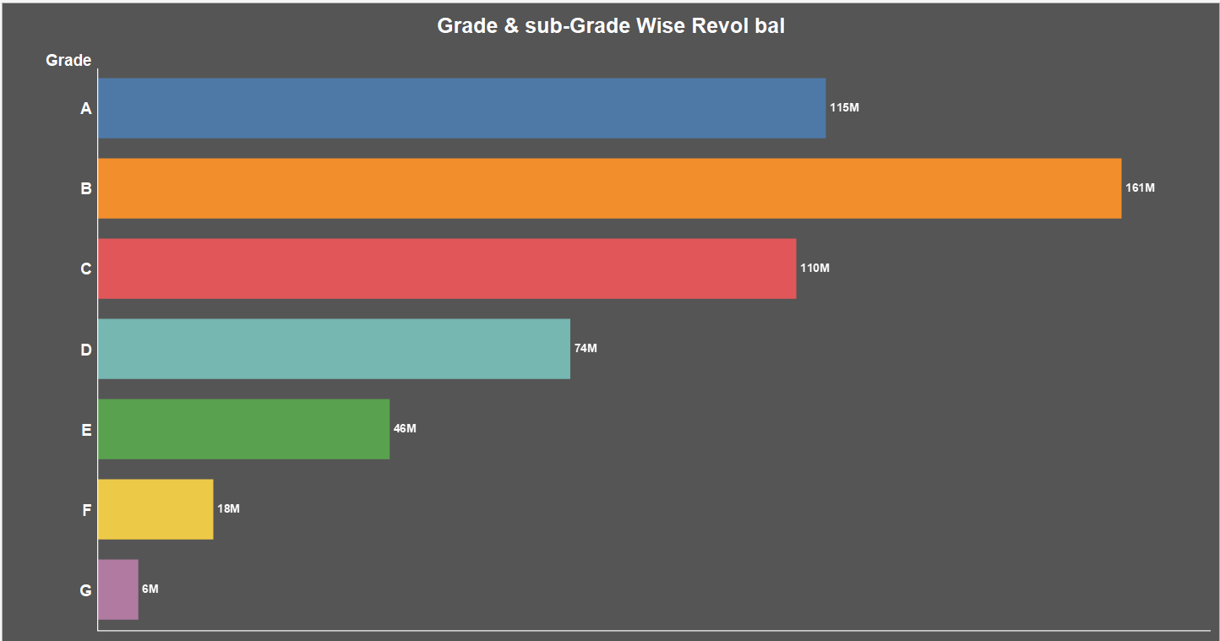
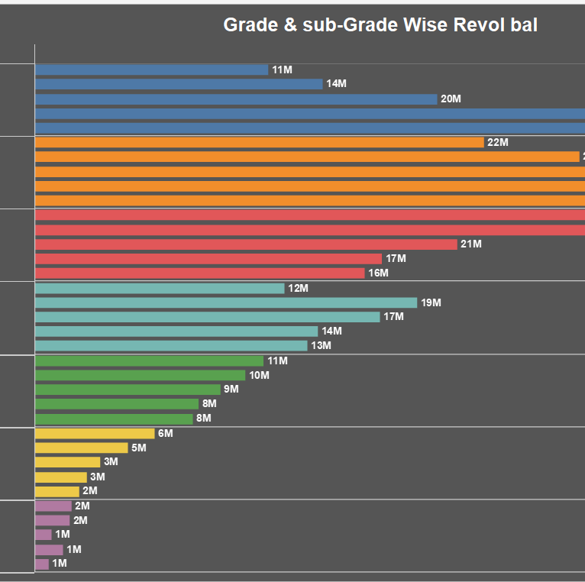
In this grade and subgrade wise revol balance we can notice grade-b have more revol balance than any other grade & grade-g have very low revol balance.
When aggregating all the points in the dataset, the grand total sum of revol_bal amounts to approximately 53,15,04,469. This represents the overall revolving balance across all the categories, reflecting the total outstanding debt or credit utilization for the entire dataset.

Slide 5
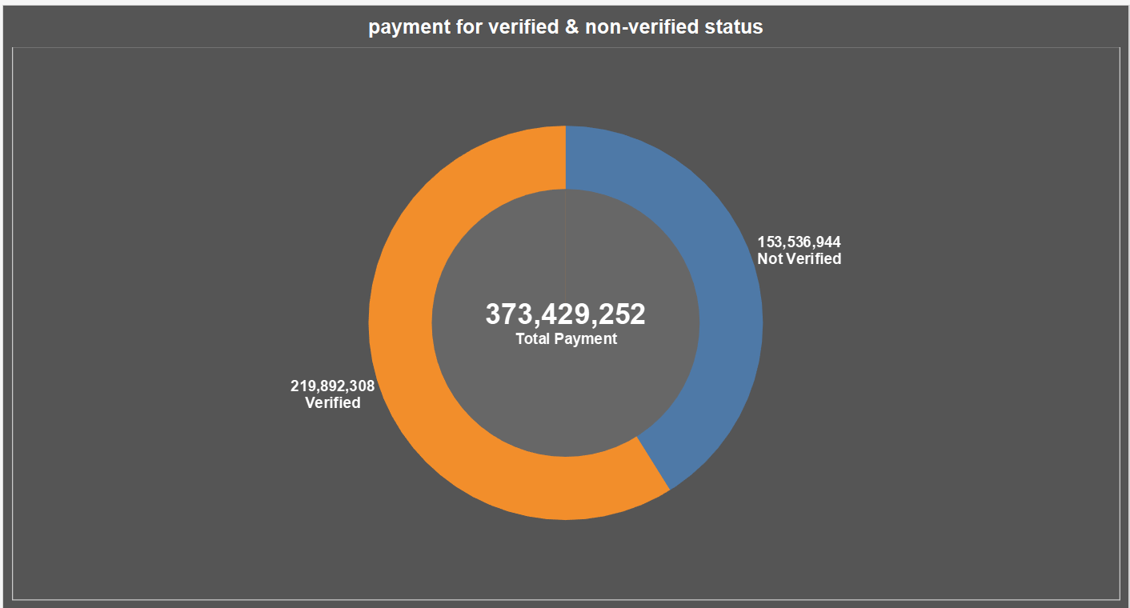
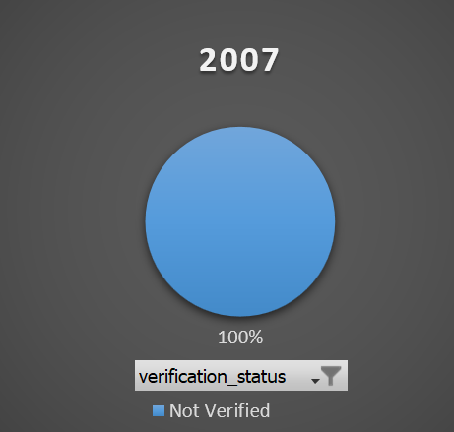
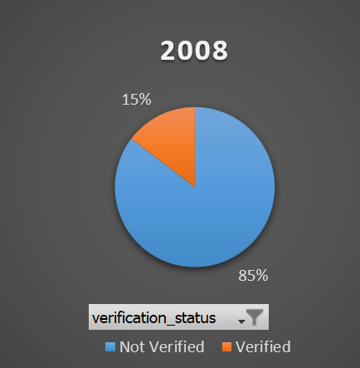
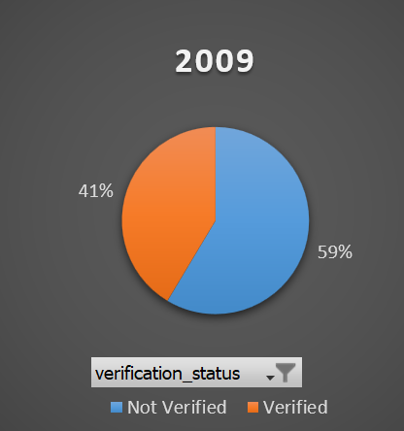
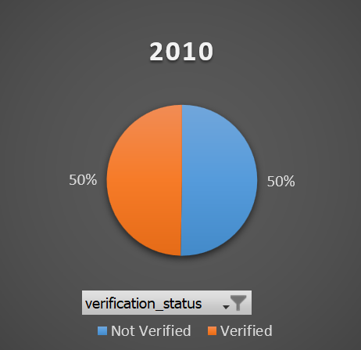
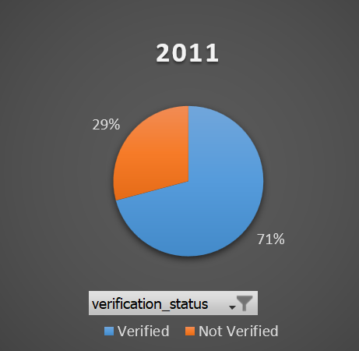
Total Payment for Verified Status Vs Total Payment for Non-Verified Status
The total payment done by all the customers is 373 M.
The total payment for verified status is 219 M and for Non-verified status is 153 M.
Which is 59% of verified payments and 41% of Non-verified payments.

Slide 6
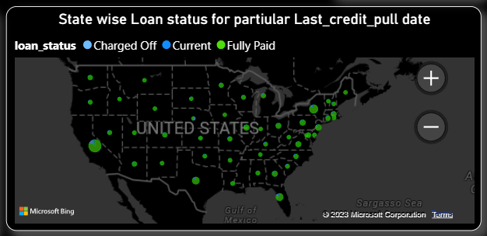
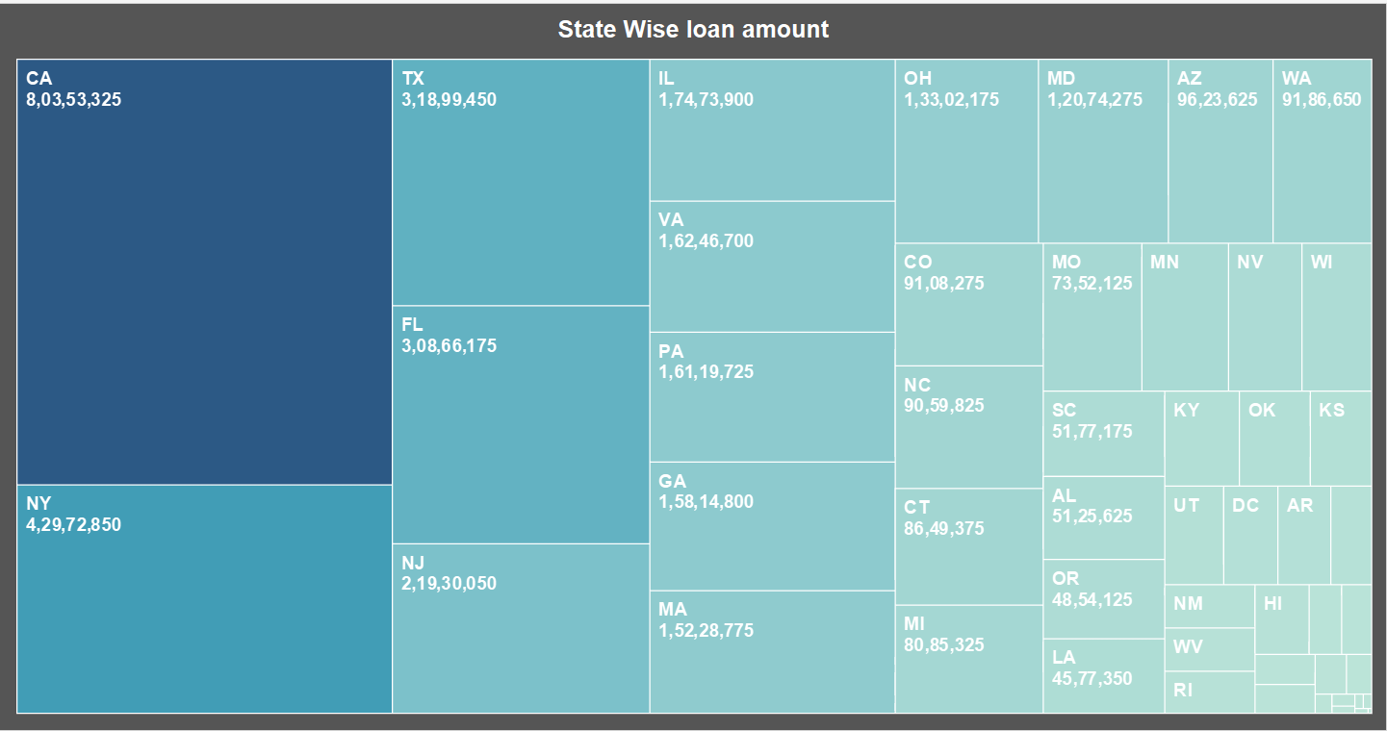
State wise and last_credit_pull_d wise loan status
The map represents the charged off, current and fully paid status of different states
This demonstrates unequivocally that in each state, 97% of bank customers are in full payment status.

Slide 7
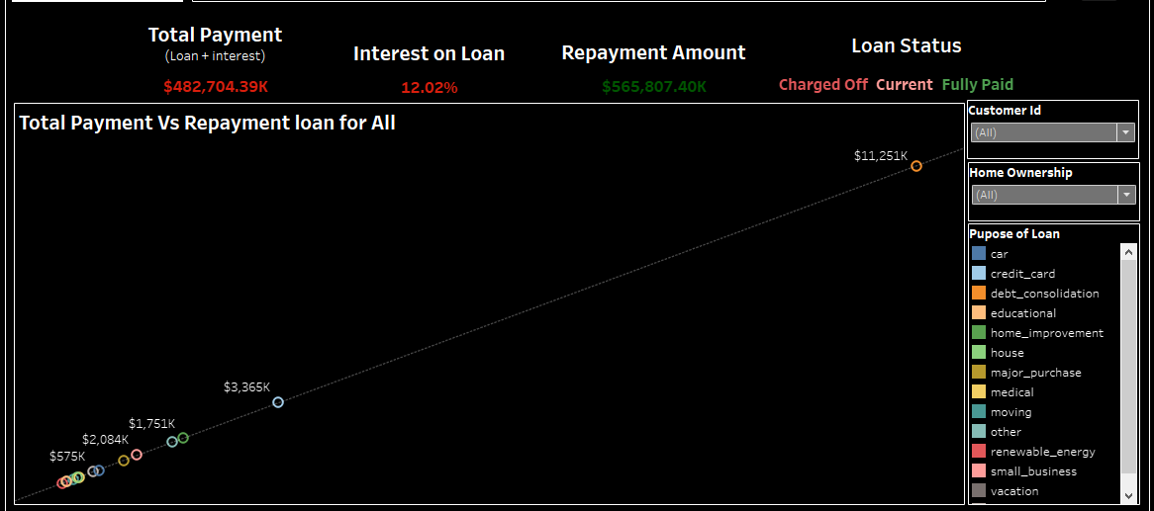
Home ownership Vs last payment date stats
We can conclude that in each home ownership, maximum loan is taken for debt consolidation and customers who took loan for this purpose has repaid in mass amount.
Except NONE and OTHERS, all other Homeownership has taken maximum loan for debt consolidation. So, recently paid max amount is of MORTGAGE followed by RENT and OWN.

Slide 8
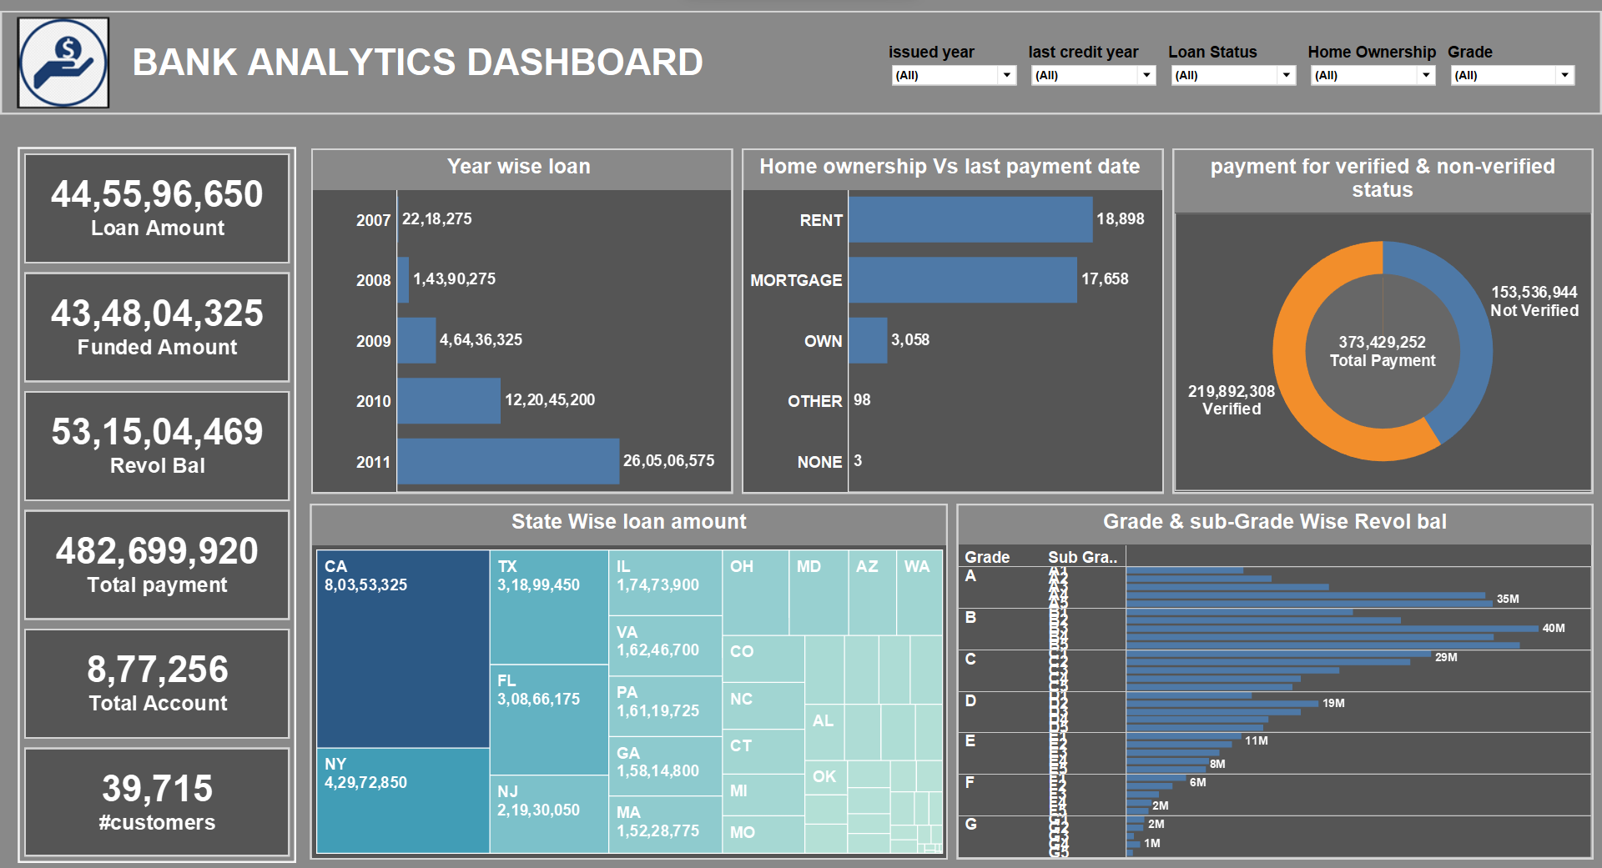

Slide 9
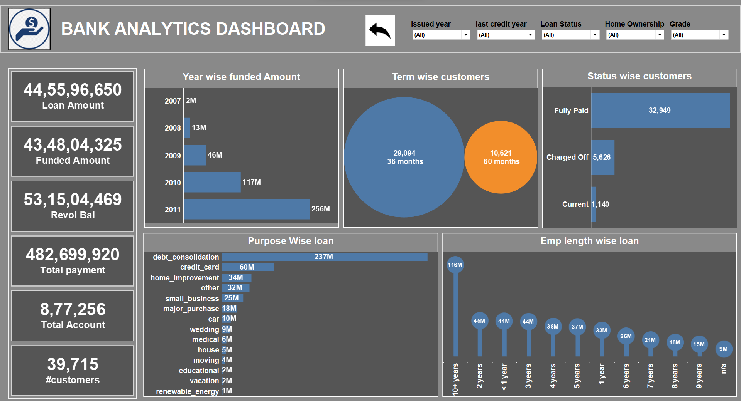

Slide 10
Findings & Suggestions
A progressive increase in loan amounts over time, the greatest revolving balance being held by Grade B, a higher percentage of verified status compared to unverified status, and the predominance of renting and mortgage payments over outright property ownership are some of the key results.
In addition, the data showed that California (CA) is now the state that contributes the most to loan payments, possibly as a result of its sizable population, diverse economy, and responsible borrowers. Home improvement, debt consolidation, and credit card refinancing accounted for most loan objectives.
It is advised to concentrate on techniques like developing stronger verification processes to raise the percentage of verified statuses in order to improve lending practices and outcomes.
Stakeholders can support borrowers' financial goals, improve risk management by utilizing these knowledge.
This research emphasizes the value of data analysis and insights in guiding wise decision-making, enhancing loan performance, and satisfying the requirements of both lenders and borrowers.

Slide 11

Thank you

